Slide 1
Four-Year Work Trends Analysis
A Data Science analysis of data gathered over my employment from January 2021 through May 2024
By Mark Fioca September 2024
Data was gathered by using RescueTime software during working hours. RescueTime Link

Slide 2


Project goal
The goal of this project is to analyze detailed time logs from a four-year period to demonstrate my evolving role as an analyst. By highlighting focus work trends, application usage, and productivity patterns, this analysis aims to justify that my responsibilities and skills align with an experienced analyst role.

Slide 3

Data Cleaning and Preparation
Overview:
In this phase, I focused on inspecting and cleaning the dataset to ensure consistency and accuracy. Key tasks included standardizing application names, handling missing values, correcting timestamp formats and identifying duplicate entries. These steps were essential to preparing the data for accurate analysis and visualization.

Slide 4
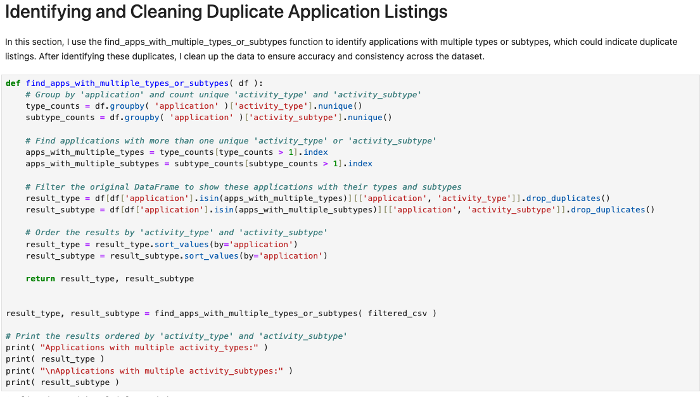
To efficiently clean and process the large dataset, I used Python within Jupyter Notebook. Custom functions automated tasks like standardizing application names, removing duplicates, and managing date and time inconsistencies. This scalable approach ensured accurate, consistent data preparation.

Slide 5
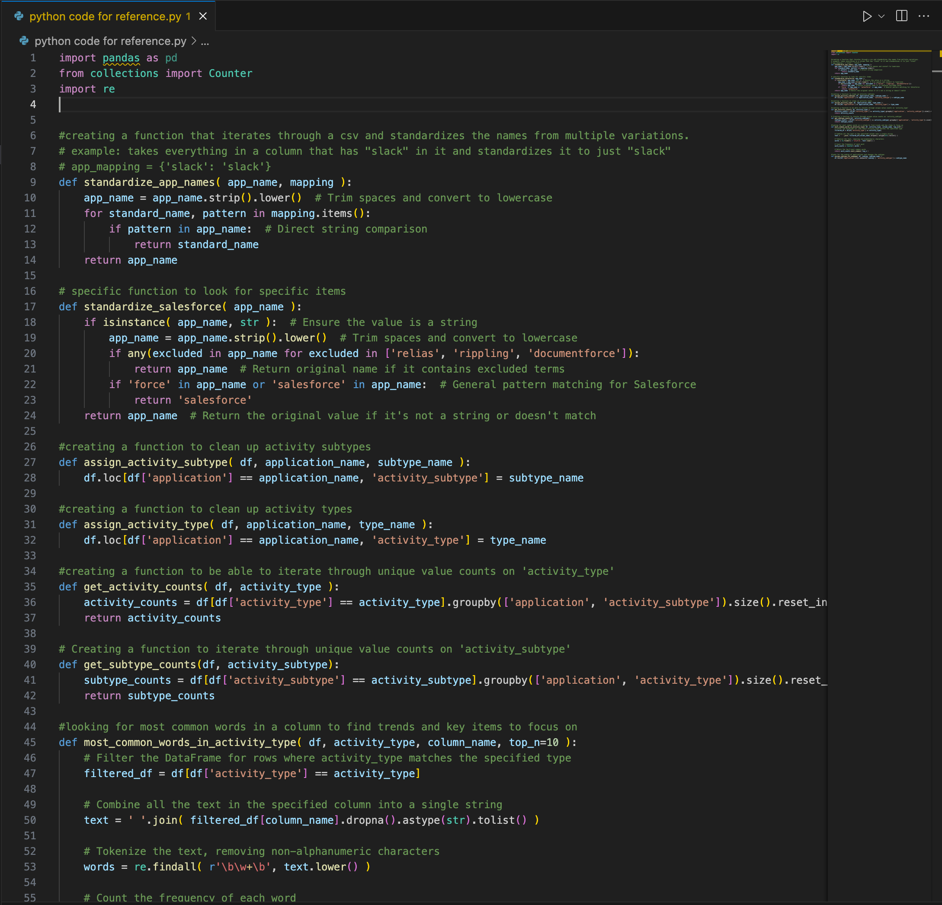
To streamline the cleanup process, I created a Python file in Visual Studio Code to document and track the custom functions used throughout the project. This allowed for easy reference and reusability, making it simpler to manage and apply functions across the dataset.

Slide 6


Data Analysis and Visualization
After cleaning the data, I conducted a detailed analysis using Python in Jupyter Notebook. This step involved generating insights into focus work, application usage, and activity patterns over time. Initial graphs were created in Jupyter to explore the data.

Slide 7
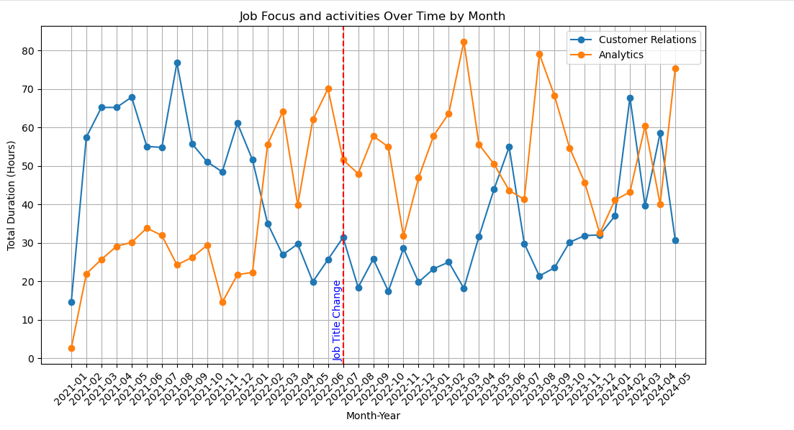
This graph illustrates the shift in job focus over time, comparing Customer Relations and Analytics activities by month. The vertical line in June 2022 marks my transition to a new job title, reflecting a formal change in responsibilities that occurred that year. Before the change, the focus was more customer relations activities, but after January 2022, there is a clear increase in analytics-related activities, signaling a shift toward more data-driven responsibilities. Then transitioning to both activity types due to a heavy focus on Auditing responsibilities for a Joint Commission Audit.

Slide 8
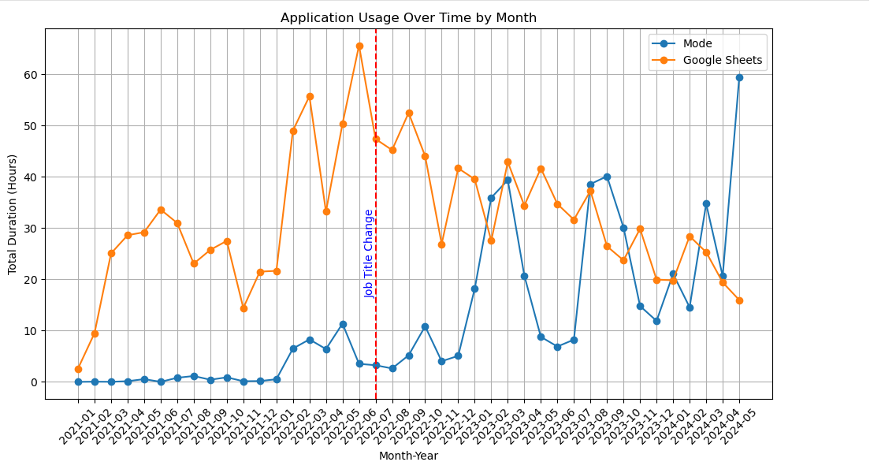
This graph shows application usage over time, specifically highlighting Mode and Google Sheets. Mode, an SQL custom report/dashboard platform, saw increased use after my job title change in June 2022, reflecting a shift toward data analysis. Prior to this transition, Google Sheets was primarily used to track customer status in the funnel. After June, as responsibilities shifted, Google Sheets was repurposed for analytics and data audit activities.

Slide 9
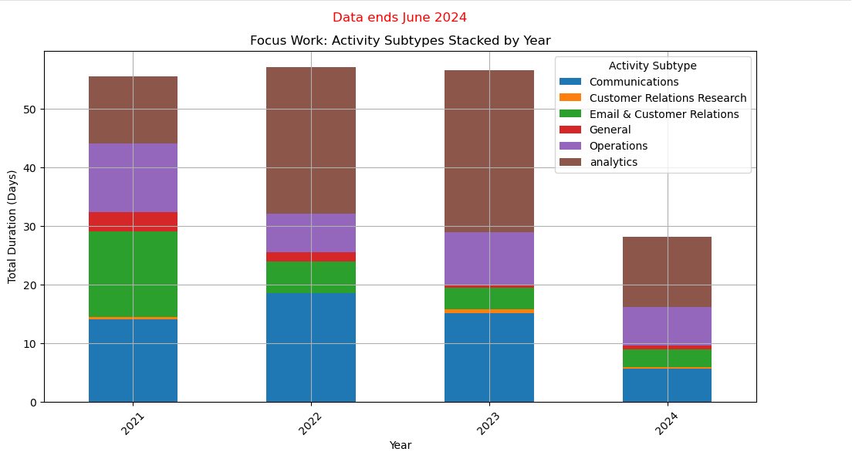
This graph shows how focus work areas like Customer Relations, Operations and Analytics evolved over the years. The stacked bars highlight changes in the distribution of time spent on these activities, offering insights into the shifting nature of my responsibilities. This visualization helps illustrate how my focus transitioned from general collection of different tasks to more data-driven and specialized analytical responsibilities, particularly following the role change in 2022.

Slide 10
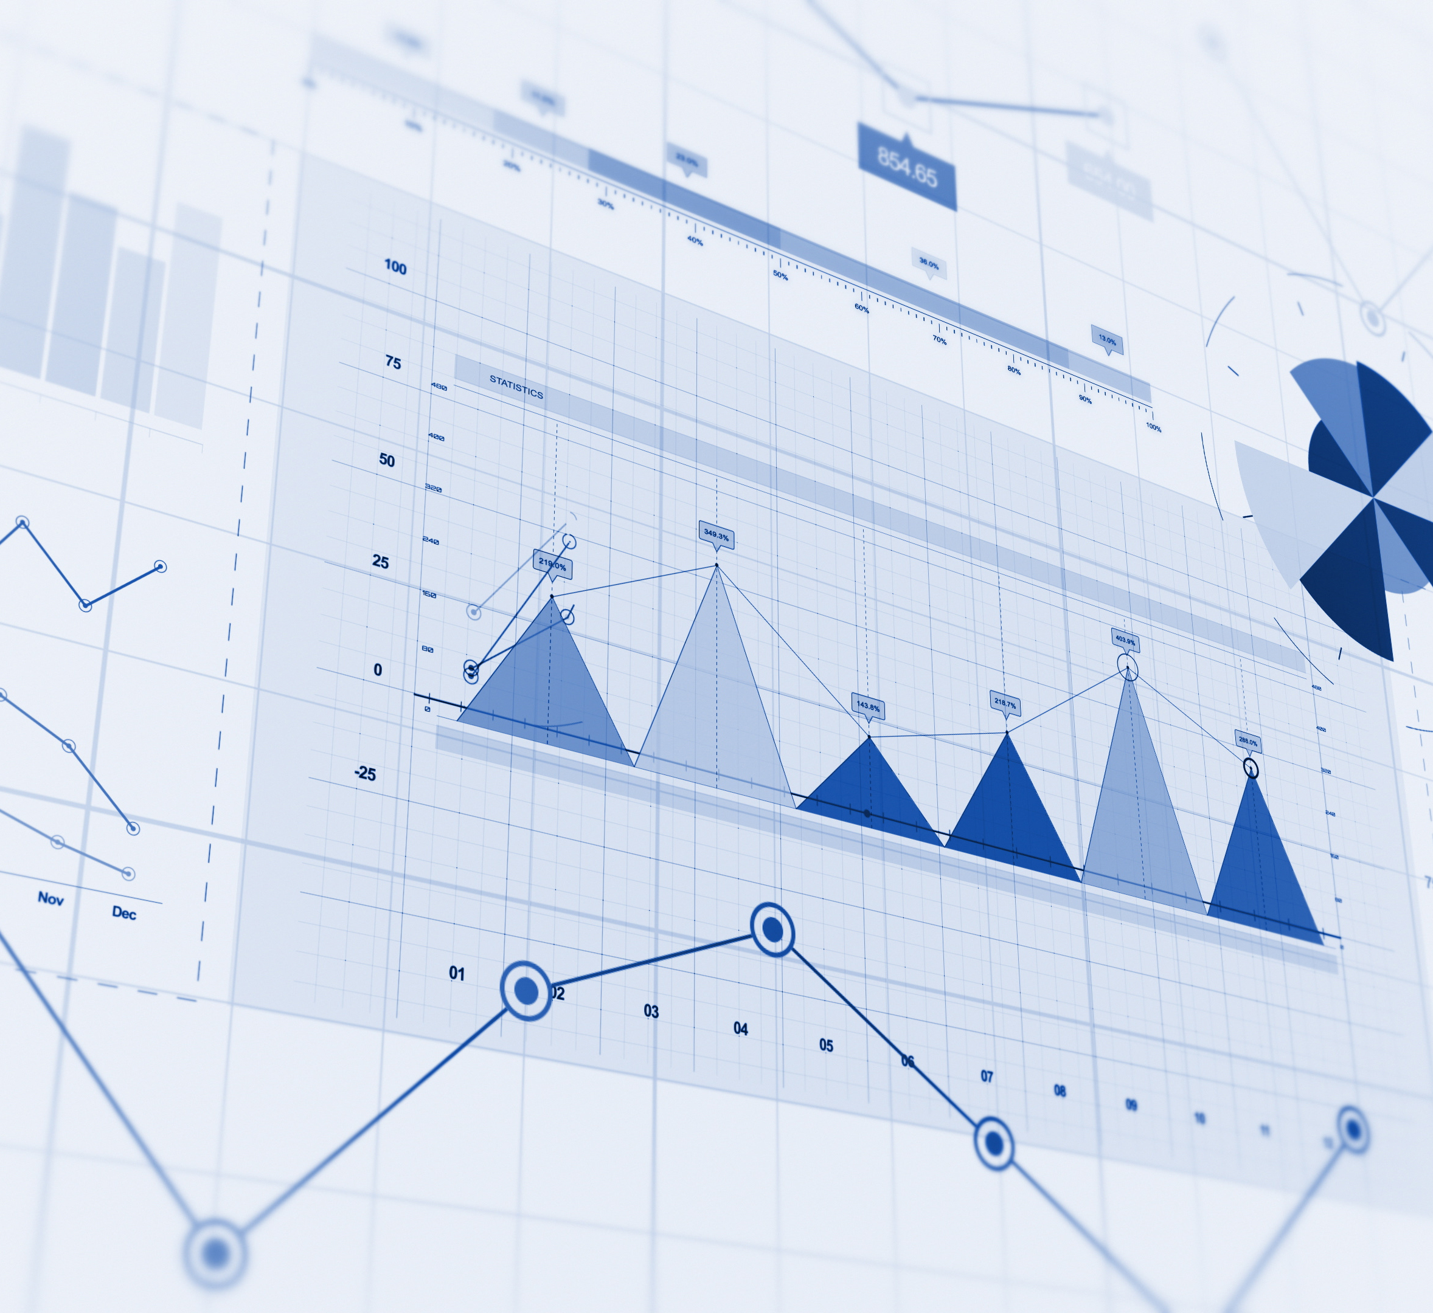
Interactive Data Visualization with Tableau
After completing the data cleaning and initial analysis, I used Tableau to create interactive dashboards that highlight key insights. These dashboards visualize trends in focus work, application usage, and productivity patterns across the four-year period. By utilizing Tableau’s dynamic features, I was able to create visualizations that allow for deeper exploration of the data, providing a clear understanding of how my responsibilities and work focus evolved over time.

Slide 11
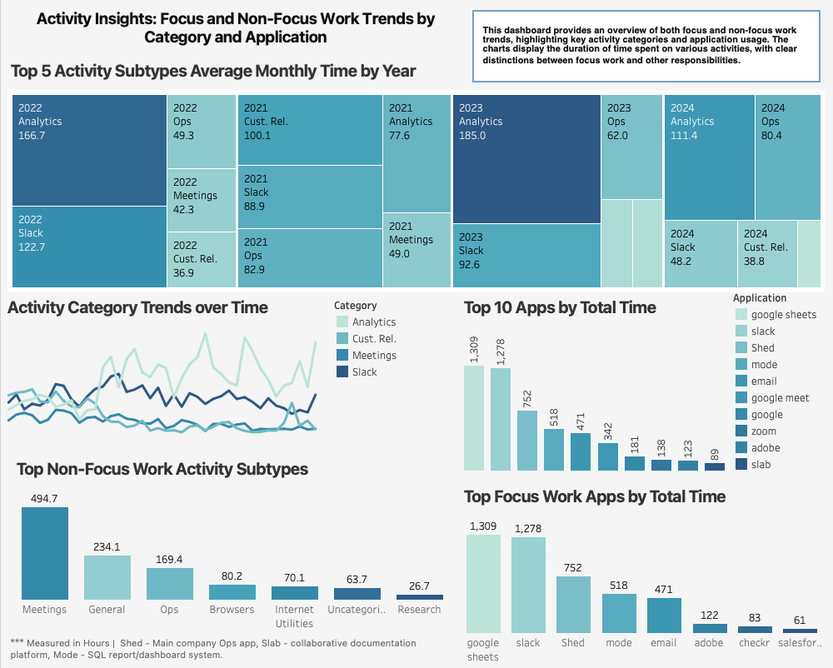
This Tableau dashboard provides a detailed look at focus and non-focus work trends, broken down by category and application usage. The visualizations highlight how time was allocated across different types of tasks and the key tools used for each. This dashboard allows for easy comparison between focus work activities and other responsibilities, offering a clear view of my evolving work patterns over the four-year period.

Slide 12
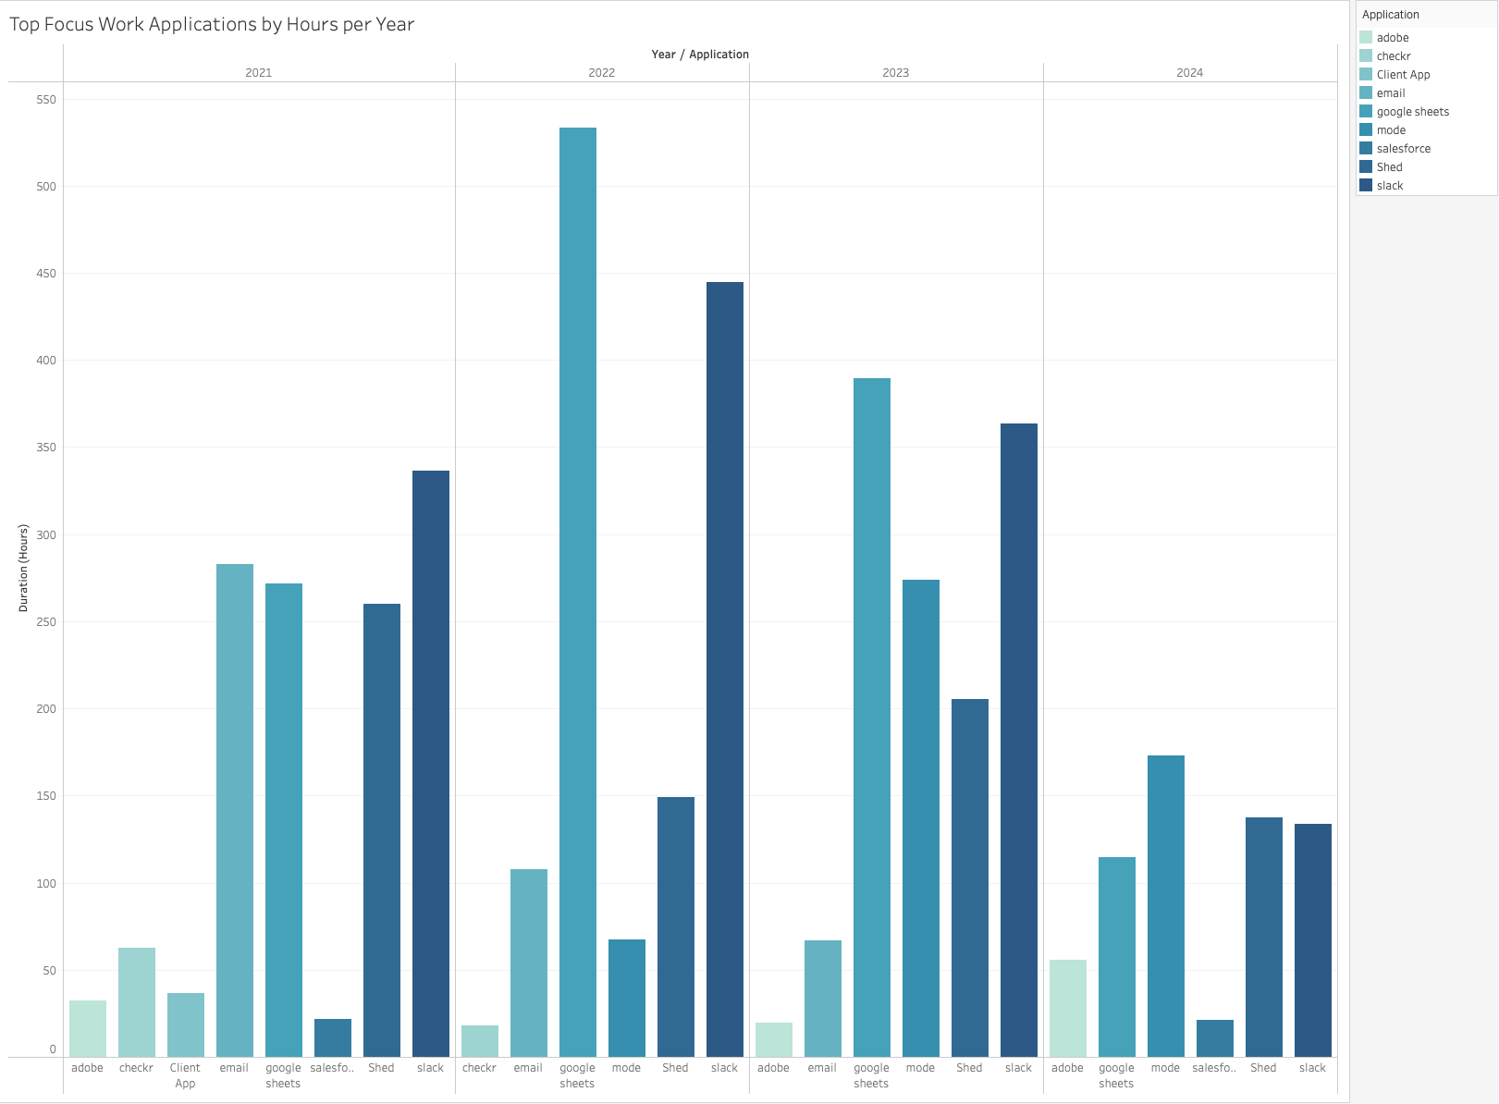
This bar graph showcases the top applications used for focus work, broken down by hours per year. It highlights the tools that played a significant role in supporting my core responsibilities. By analyzing usage trends over time, this graph provides insights into which applications became more prominent as my work evolved, particularly in tasks that required dedicated focus. Data collection ended in June of 2024 which explains the lower number of hours.

Slide 13
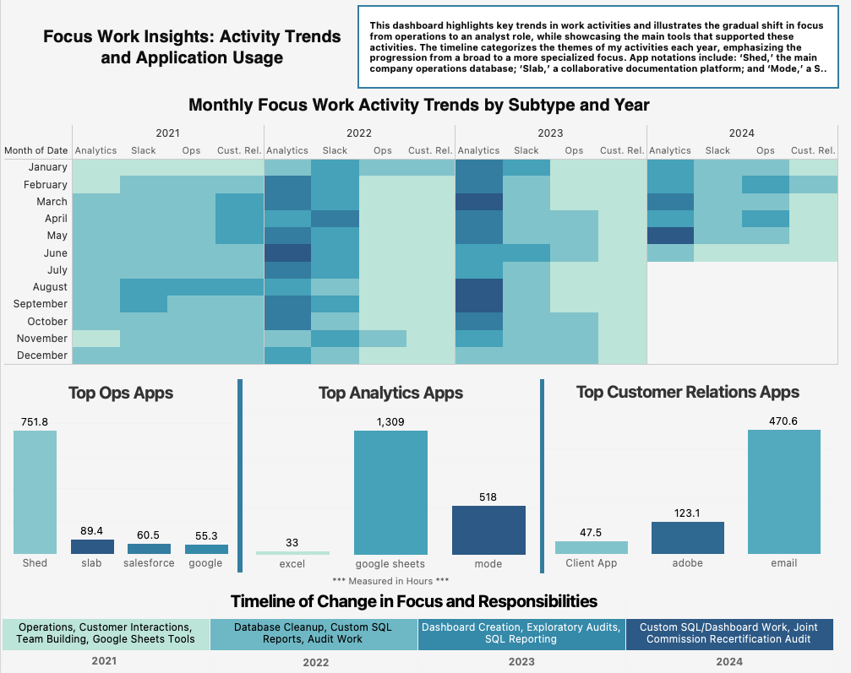
This dashboard provides a comprehensive view of focus work activity trends and application usage over time. The heatmap illustrates shifts in activity intensity by month and year, revealing patterns in how focus work was distributed. Additionally, the dashboard highlights key applications used during these periods, offering insights into which tools supported my most critical tasks.

Slide 14

Key Takeaways and Insights
Shift Toward Analytics: Over time, my role increasingly focused on analytics work, as evidenced by the growing use of tools like Mode and a higher percentage of analytics activities compared to total work time.
• Application Usage Patterns: Certain applications, such as Mode and Google Sheets, played a significant role in different phases of my work. The shift in application usage after January 2022 shows a clear transition in job responsibilities.
• Focus Work Distribution: The heatmaps and stacked bar charts reveal how focus work was distributed throughout the years, highlighting key activity categories.
• Consistency in Productivity: The consistent focus work trends and application usage over the four-year period underscore my ability to maintain productivity, even as job responsibilities shifted.

Slide 15

Conclusion: Demonstrating Analytical Expertise
This project highlights my ability to clean, analyze, and visualize large datasets over a four-year period. By showcasing focus work trends, application usage, and evolving responsibilities, I have demonstrated my analytical skills and proven that my role aligns with that of an experienced analyst. The insights gained from this project underscore my ability to manage complex data and generate valuable, actionable results.

